Slide 1


DESIGN AND DEVELOPING A WASTE CLASSIFICATION MODEL BASED ON MACHINE LEARNING

Slide 2
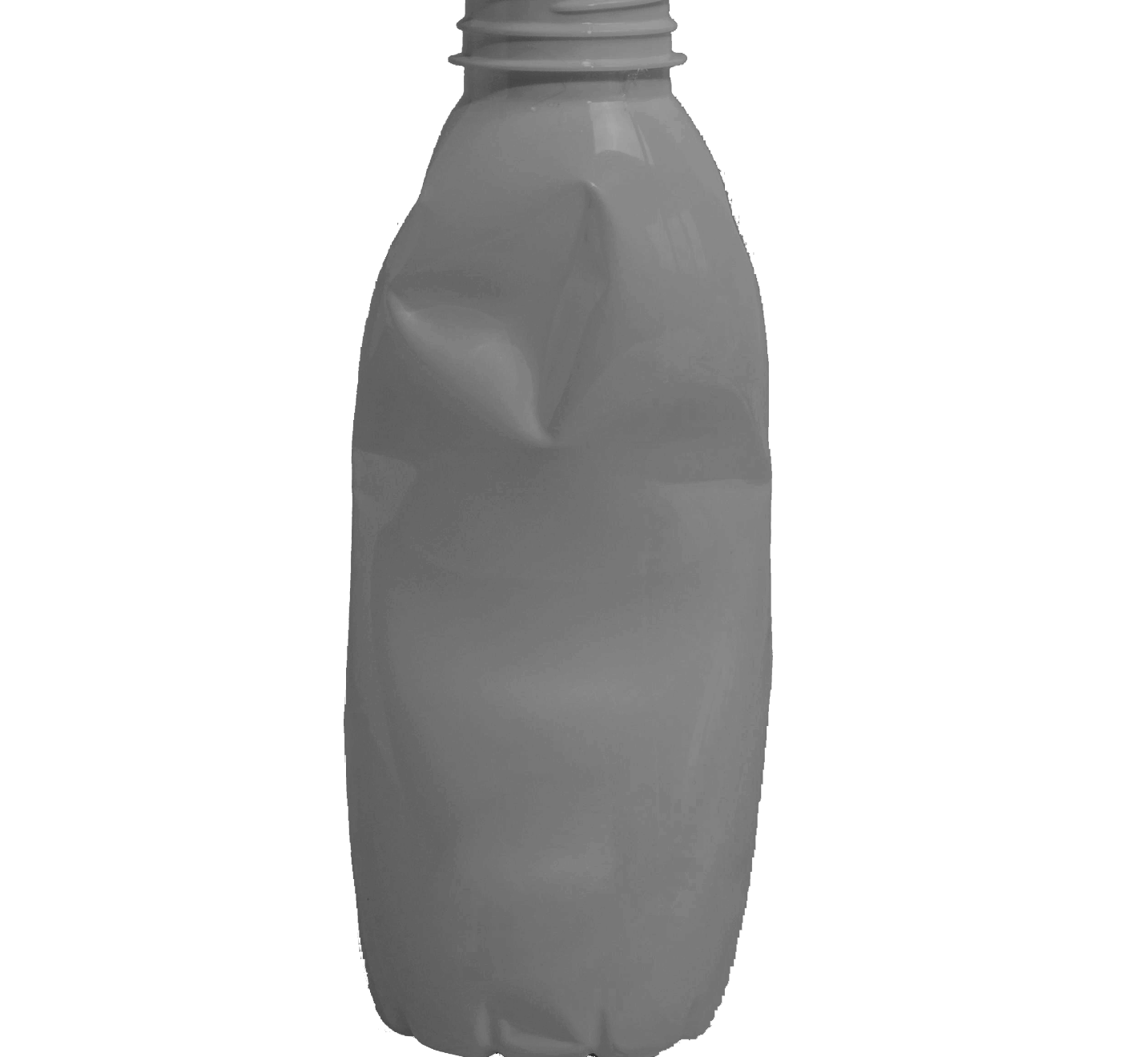
INTRODUCTION
Waste management is a pressing global issue, and the need for efficient waste classification has never been more critical. In the initial phases of this project, I implemented the model utilizing the VGG16 CNN Architecture. Subsequently, in pursuit of enhanced proficiency, I transitioned to the Inception Architecture for more robust and efficient results.

Slide 3
WHY IS WASTE CLASSIFICATION IMPORTANT?
Waste classification is vital for:
1. RESOURCE RECOVERY: Identifying valuable materials for recycling.
2. HEALTH AND SAFETY: Managing hazardous waste to protect people and the environment.
3. CIRCULAR ECONOMY: Promoting recycling and minimizing environmental impact.
4. ECONOMIC OPPORTUNITIES: Creating jobs and conserving resources.
5. REGULATORY COMPLIANCE: Meeting legal requirements for proper waste management.

Slide 4
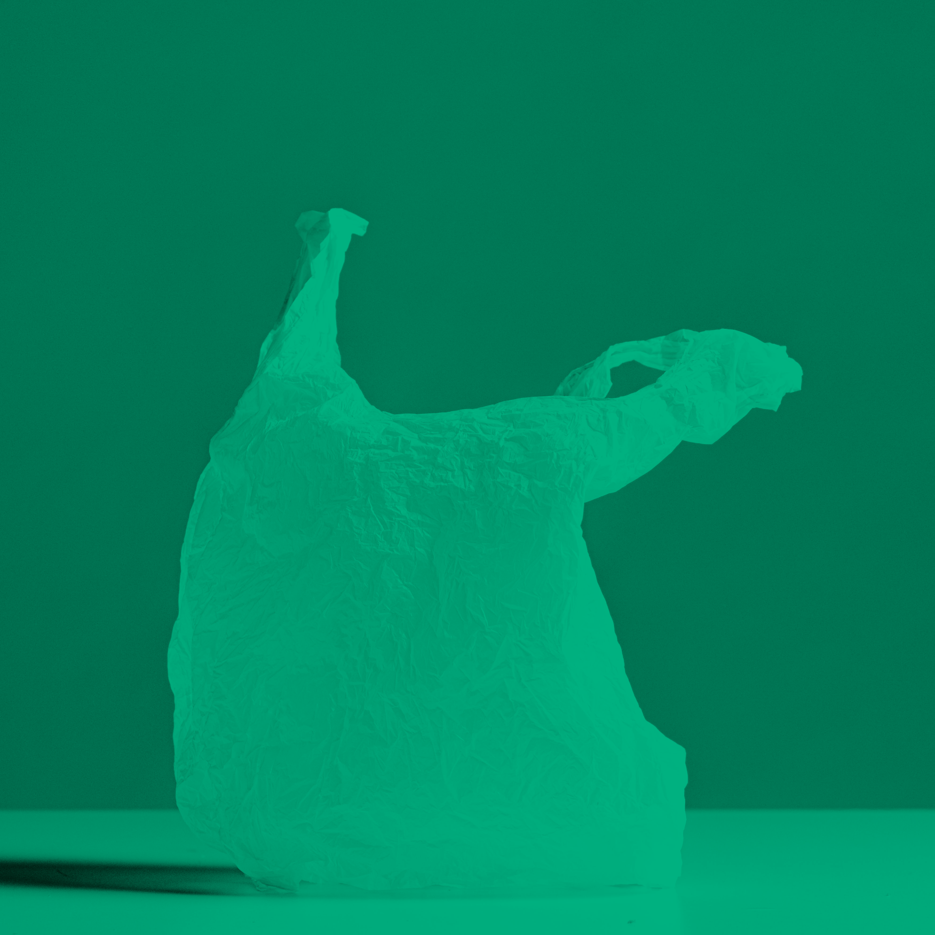
PROBLEM NOVELTY
In my pursuit, I initially deployed the VGG16 architecture, a well-established convolutional neural network (CNN), to handle the diverse nature of waste materials. While VGG16 provided a solid foundation, I recognized the need for innovation to enhance adaptability to different waste streams.

Slide 5
VGG16
ARCHITECTURE:
VGG16, or the Visual Geometry Group 16-layer model, is a convolutional neural network (CNN) architecture that was introduced by the Visual Geometry Group at the University of Oxford. It gained prominence for its simplicity and effectiveness in image classification tasks.
VGG16 consists of 16 weight layers, including 13 convolutional layers and 3 fully connected layers.
Convolutional layers use small 3x3 filters with a stride of 1, and max-pooling is applied with a 2x2 filter and a stride of 2.
by Slidesgo
Solid waste management

Slide 6
SOLUTION NOVELTY
The key innovation lies in the adaptability of our model, transitioning from the widely-used VGG16 to the more sophisticated Inception architecture. This transition allowed our model to effectively capture intricate patterns and features present in different waste compositions, significantly improving the accuracy of waste classification.

Slide 7
INCEPTION
ARCHITECTURE:
The Inception architecture consists of 22 layers. This count includes both convolutional and fully connected layers. The network achieves its depth and expressive power through the use of multiple Inception blocks, each containing parallel operations with different filter sizes (1x1, 3x3, 5x5) and pooling operations.
The Inception architecture, also known as GoogLeNet, is a convolutional neural network (CNN) architecture designed to address computational efficiency while maintaining high accuracy in image classification tasks. It was introduced by Google researchers in the Inception paper published in 2014.

Slide 8
VGG16:
ARCHITECTURE:
VGG16 (Visual Geometry Group 16) is part of the VGG family, which was proposed by the Visual Geometry Group at the University of Oxford.
It is characterized by its simplicity and uniformity in architecture. VGG16 consists of 16 weight layers, including 13 convolutional layers and 3 fully connected layers.
CONVOLUTIONAL LAYERS:
VGG16 uses 3x3 convolutional filters with a stride of 1 throughout the network. It stacks multiple convolutional layers before downsampling using max-pooling layers.
PARAMETER SHARING:
The use of small 3x3 filters with a small stride allows VGG to use a smaller number of parameters and encourages parameter sharing.
INCEPTION:
ARCHITECTURE:
Inception, or GoogLeNet, was proposed by researchers at Google. It is known for its "Inception modules," which use multiple filter sizes within the same layer.
It is designed to capture information at multiple scales and has a more complex architecture compared to VGG.
INCEPTION MODULES:
Inception modules consist of parallel convolutional operations with different filter sizes (1x1, 3x3, 5x5) and pooling operations. This allows the network to capture features at different spatial scales.
PARAMETER EFFICIENCY:
The use of 1x1 convolutions is a key feature in Inception. These 1x1 convolutions help reduce the number of parameters and computational cost while allowing the network to capture complex patterns.

Slide 9
LIBRARIES USED
1. NUMPY:
It is a powerful library for numerical operations in Python. It provides support for large, multi-dimensional arrays and matrices, along with a collection of mathematical functions to operate on these elements.
2. PANDAS:
It is a data manipulation and analysis library. It provides data structures like DataFrame for efficient manipulation and analysis of structured data.
3. MATPLOTLIB:
It is a plotting library for creating static, animated, and interactive visualizations in Python.
The pyplot module provides a convenient interface for creating plots and charts.
4. MATPLOTLIB IMAGE:
This module provides functionality for reading, displaying, and manipulating image data.
5. OPERATING SYSTEM:
This module provides a way to interact with the operating system. It is commonly used for tasks like navigating file systems, working with file paths, and executing system commands.

Slide 10
cntd..
6. KERAS LAYERS (LAYERS):
Provides access to various layers like Conv2D, Dense, Activation, etc., which are fundamental components in building neural network architectures.
7. KERAS MODEL (MODEL)
It is used to create and instantiate a model in Keras. It allows you to define the architecture of your neural network by specifying the input and output layers.
8. IMAGEDATAGENERATOR:
ImageDataGenerator is a powerful tool for augmenting and preprocessing image data on-the-fly during model training. It helps improve the model's generalization by creating variations of the training images.
9. VGG16 MODEL (VGG16):
It instantiates the VGG16 model in the code. It can use the pre-trained weights from ImageNet or fine-tune the model for a specific task.

Slide 11
cntd..
10. PREPROCESS INPUT FUNCTION:
The preprocess_input function is used to preprocess input images before feeding them into the VGG16 model. It performs normalization and other preprocessing steps required for compatibility with the model's training data.
11. ADAM OPTIMIZER (ADAM):
Optimizers are used to minimize the loss function during the training process by adjusting the model's weights. The Adam optimizer adapts the learning rates of individual parameters, providing a balance between adaptability and stability.
12. CONFUSION_MATRIX:
It is used to compute the confusion matrix to evaluate the accuracy of a classification.
13. CLASSIFICATION_REPORT:
It generates a text-based report showing the main classification metrics, such as precision, recall, f1-score, and support, for each class. It is useful for evaluating the performance of a classification model on a per-class basis

Slide 12
cntd..
14. SEABORN:
Seaborn is a statistical data visualization library based on Matplotlib. It provides a high-level interface for drawing attractive and informative statistical graphics. The sns alias is often used for convenience.
15. KERAS MODEL LOADING:
This function from Keras allows you to load a pre-trained model saved in the Hierarchical Data Format (HDF5) file format. This is useful for reusing trained models or for fine-tuning.
16. TENSORFLOW IMAGE PREPROCESSING:
IMG_TO_ARRAY: converts a PIL (Python Imaging Library) image or a Keras image tensor to a NumPy array.
LOAD_IMG: loads an image from a file path.

Slide 13
CODE DEMONSTRATION

Slide 14
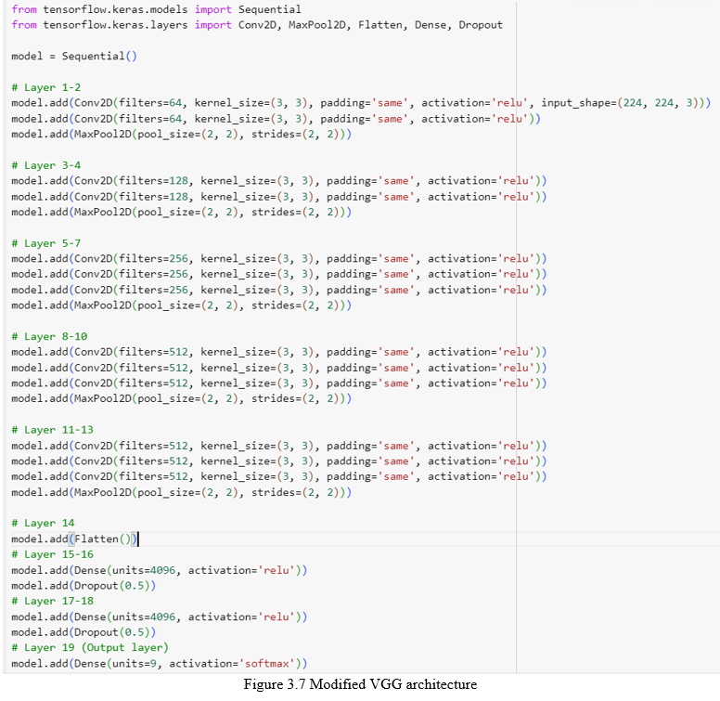

Slide 15
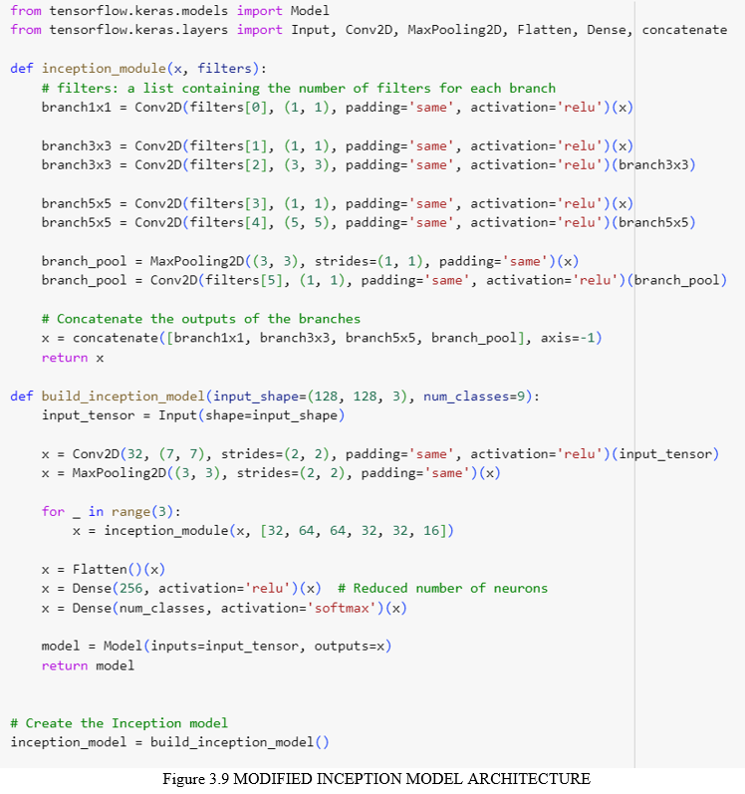

Slide 16
Result Analysis

Slide 17
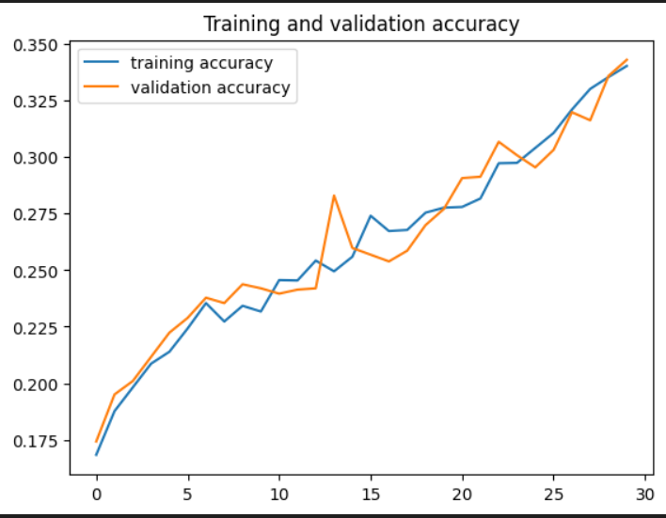
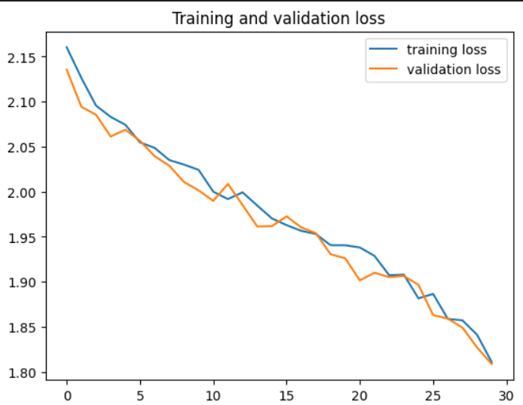
VGG

Slide 18
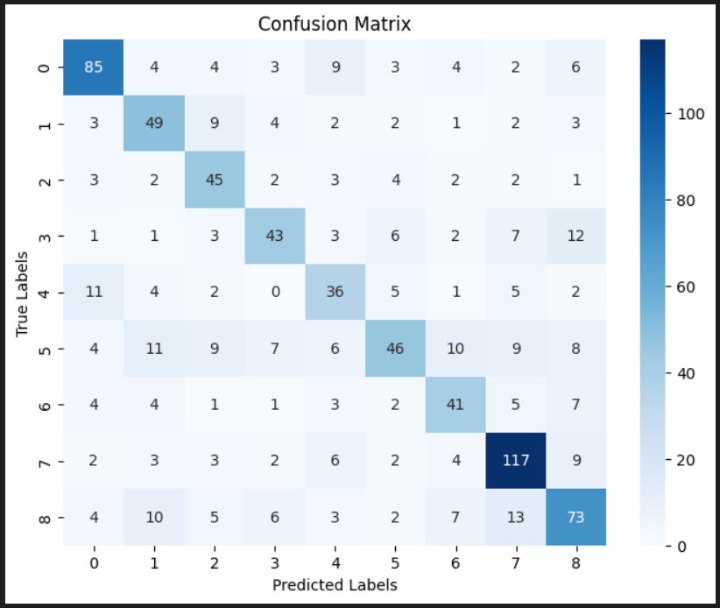

Slide 19
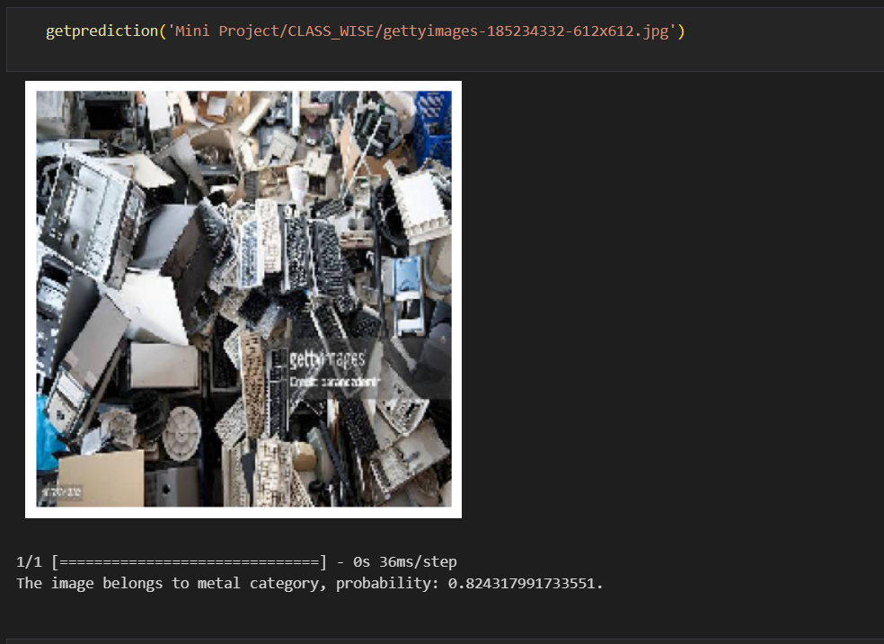

Slide 20
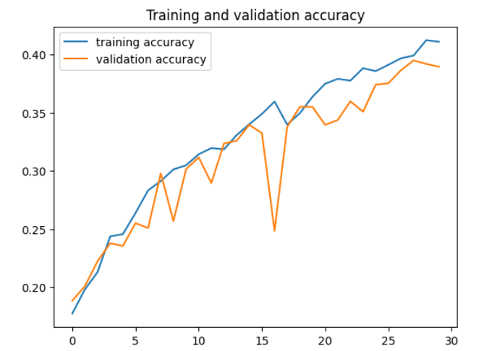
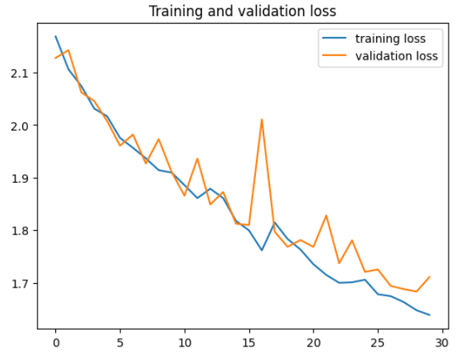
INCEPTION

Slide 21
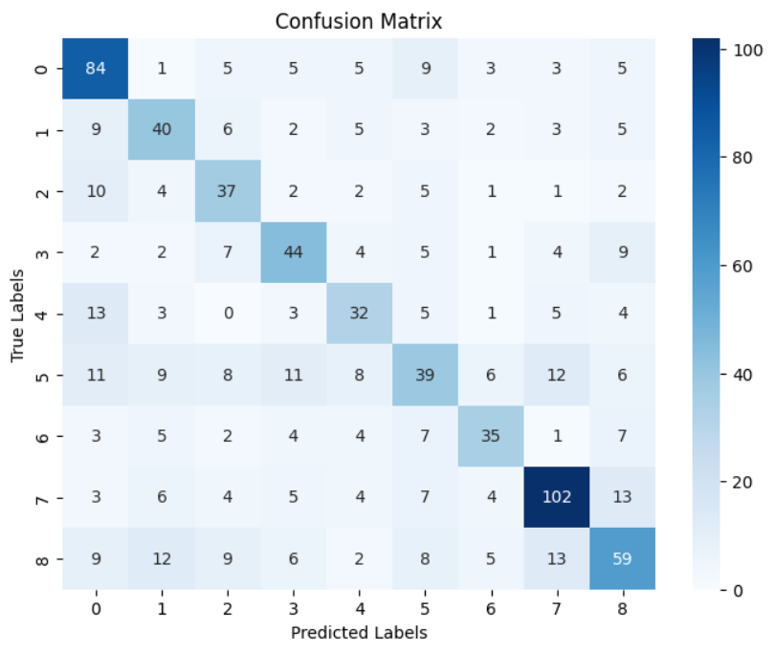

Slide 22
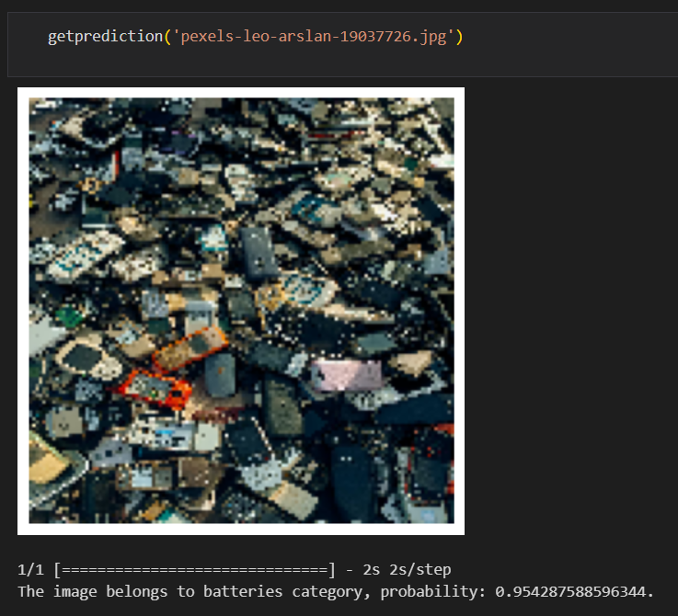

Slide 23
DIFFICULTIES FACED
GPU Limitations on Google Colab:
Training deep learning models demands substantial computational power, and using a robust GPU can significantly accelerate the process. Google Colab provides free GPU resources, but the availability might be limited, leading to longer training times.
Without leveraging a pre-trained model, the model has to learn features from scratch, intensifying the need for ample GPU resources.
Google Colab Runtime Issues:
During model training, encountering internal Python errors can be frustrating. In some cases, the recommended solution involves restarting the Colab runtime. However, this disrupts the training process, resulting in wasted time.
The limitations of the Colab environment may not always provide a seamless experience, and users might face interruptions due to runtime crashes or resource restrictions.

Slide 24
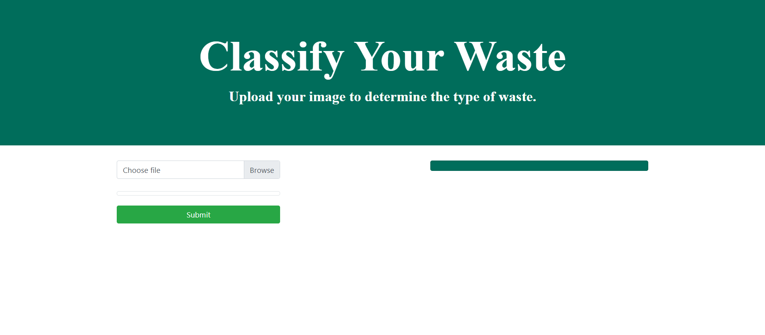

Slide 25
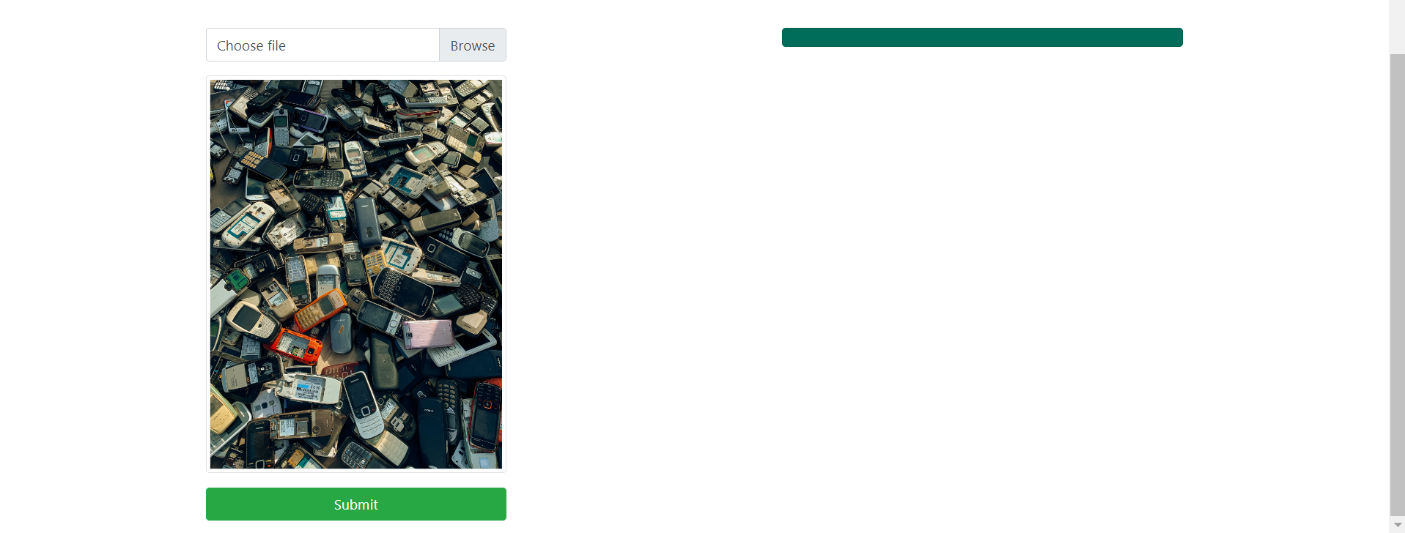

Slide 26
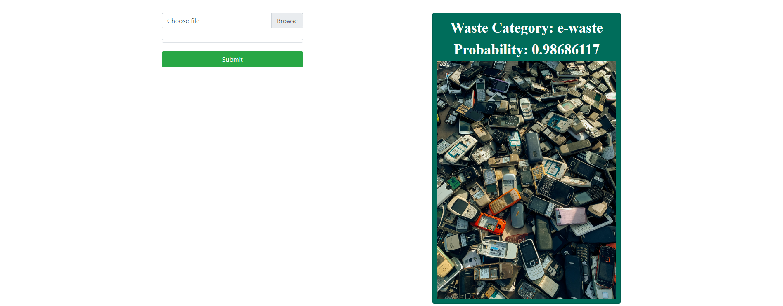

Slide 27
THANK YOU

